Slide 1
a presentation
Generated by VisionDeck

Slide 2

Introducing EcoHouse: Your Gateway to Sustainable Living

Slide 3
Our Mission:
To empower homeowners to build and live sustainably.
Our Solutions:
- Eco-friendly building materials
- Energy-efficient appliances
- Renewable energy solutions
- Water conservation systems

Slide 4

We offer a wide range of sustainable building materials, including:
- Recycled and reclaimed wood
- Bamboo flooring
- Natural stone
- Sustainable insulation

Slide 5
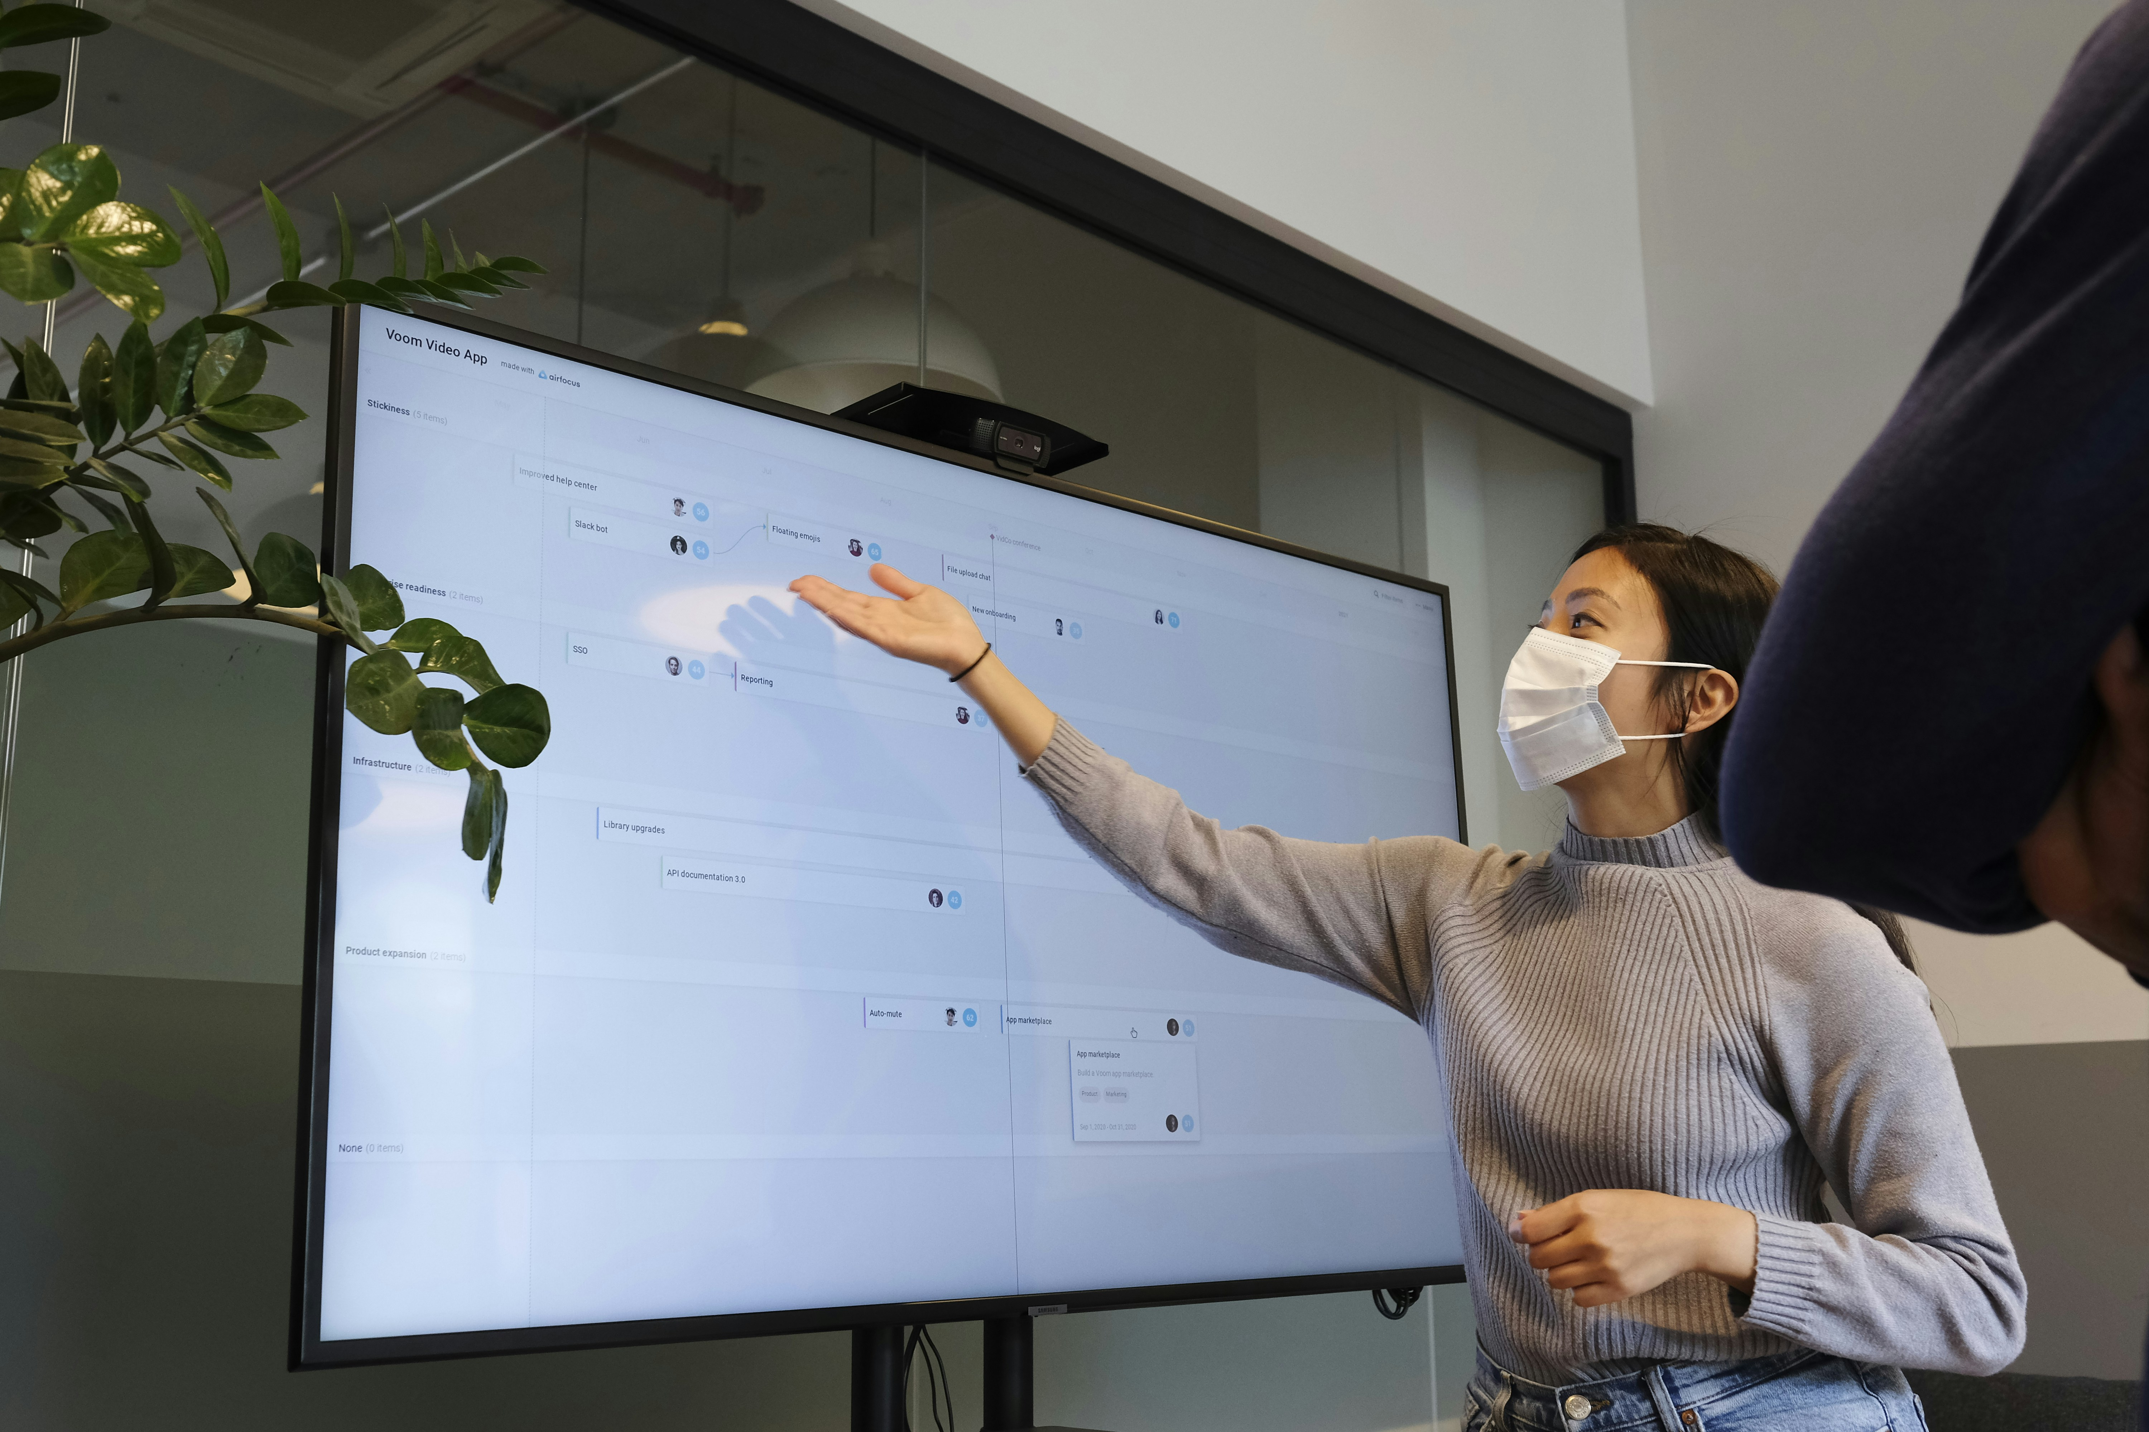
Reduce your energy consumption and save money with our:
- High-efficiency HVAC systems
- Smart thermostats
- LED lighting
- Solar panels

Slide 6
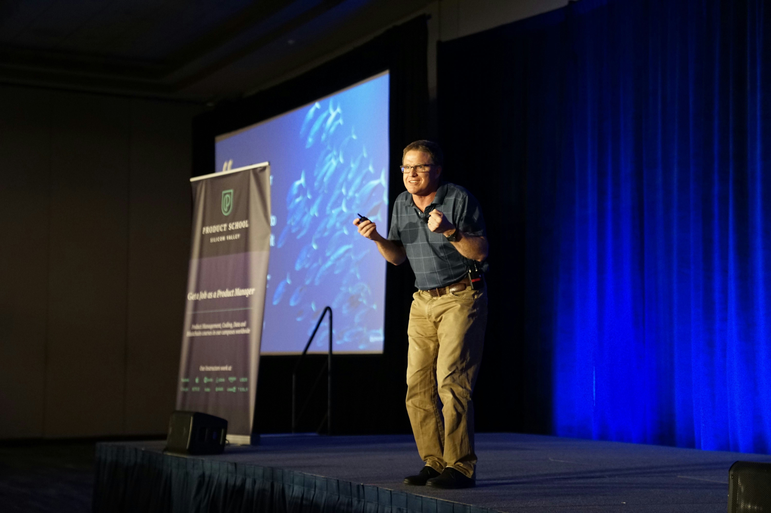
Conserve water and protect our environment with:
- Low-flow showerheads and faucets
- Water-efficient appliances
- Rainwater harvesting systems
- Greywater recycling

Slide 7
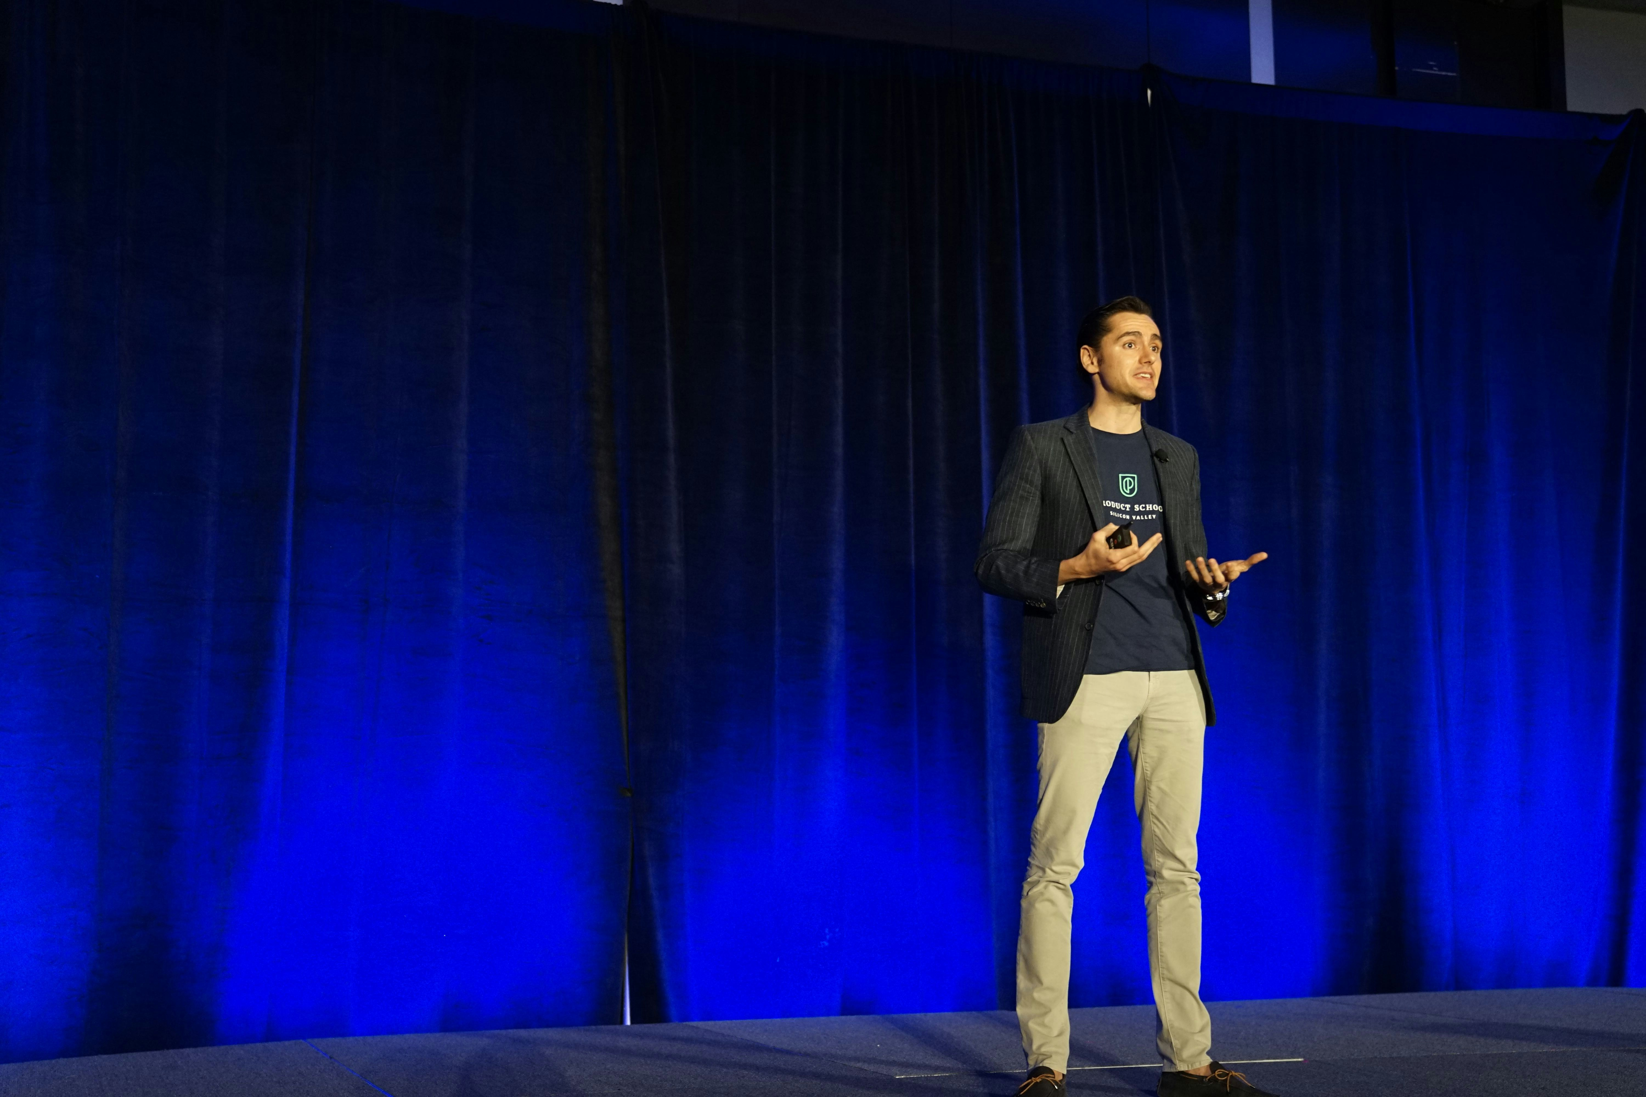
Contact us today to learn more about our eco-friendly solutions and how we can help you create a sustainable home.
Together, let's build a greener future!

